Slide 1
Capstone Project Presentation
Smart Chair
Group: EEERGC0197
Under the Guidance of
Mr. Nitin Kumar
Assistant Professor, Robotics and Automation
Department of ECE
Lovely Professional University
SEERAPU PANKAJ (11304116)
RAMA KRISHNA BOLLU (11304627)
B. JEEVAN BABU (11303957)
S.DEVENDRA KUMAR (11309852)

Slide 2
Introduction
The main Objective of the project is to create a chair that can ease the human’s life style and assist human in doing the featured tasks.
This Chair has a feature of virtual notes or a digital note that is developed with an intension of avoiding paper notes and ink.
The most common problem faced by students is sitting for long hours in study chair they get tired as well as the back rest of the chair is not as the same height of the person sitting in the chair.
This chair is secured and alerts the user when the chair is accessed.

Slide 3
Components Used
Raspberry Pi 3 HDMI to VGA Converter
7 inch 1024*600 LCD Panel VGA Cable LCD driver board Electro-Mechanical Linear Actuators ARDUINO UNO 4 wire Resistive Touch Pad Bluetooth Module Ultrasonic Sensor IR Sensor PIR Sensor Relay 12v DC Adapter USB Cable
Switches

Slide 4
Virtual Notes

Slide 5
Benefits of Using this Module
The Concept of Virtual notes is to make a digital notes which doesn’t require pen and paper to record the writing.
This is a future scope of a digital notes where it could serve as medium of saving paper.
Touch pad coordinates can be seen in real time

Slide 6
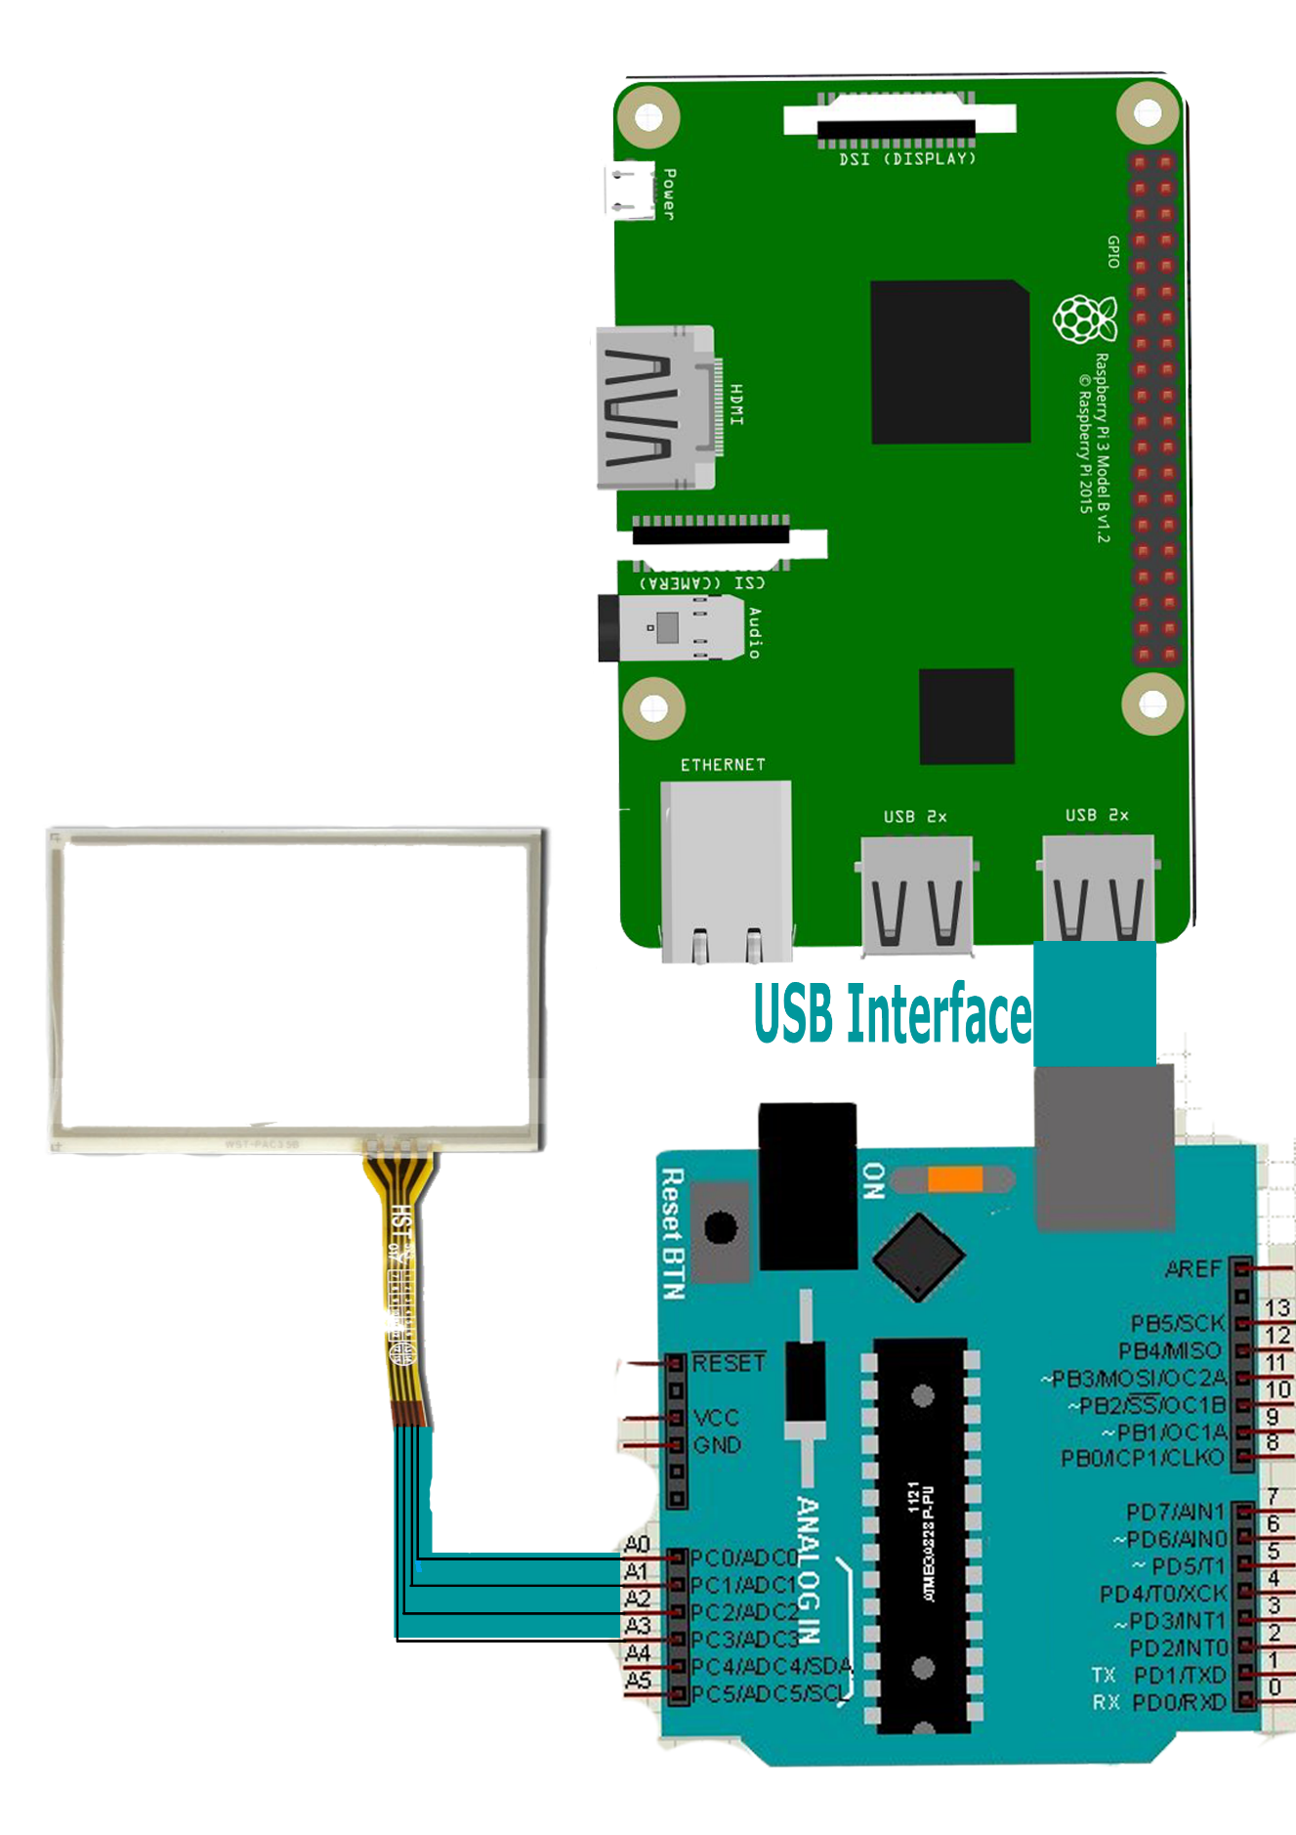
Circuit Description

Slide 7
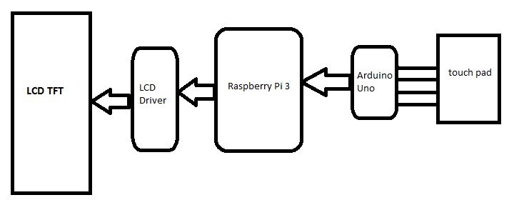
Block Diagram

Slide 8
E-Mail of Captured Notes

Slide 9
Benefits of Using this Module
The Notes that is written on LCD Screen from the touch pad is captured by providing a keyboard interrupt.
This notes captured is stored in a directory inside the memory of raspberry pi.

Slide 10
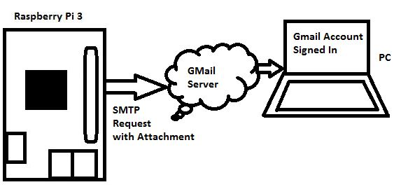
Block Diagram

Slide 11
Unauthorized Access of Chair

Slide 12
Benefits of Using this Module
The Chair is having a feature of sending message to a registered mobile number whenever this chair is accessed.
This is accomplished by monitoring PIR (passive infrared sensor) to detect radiation emitted from humans.

Slide 13
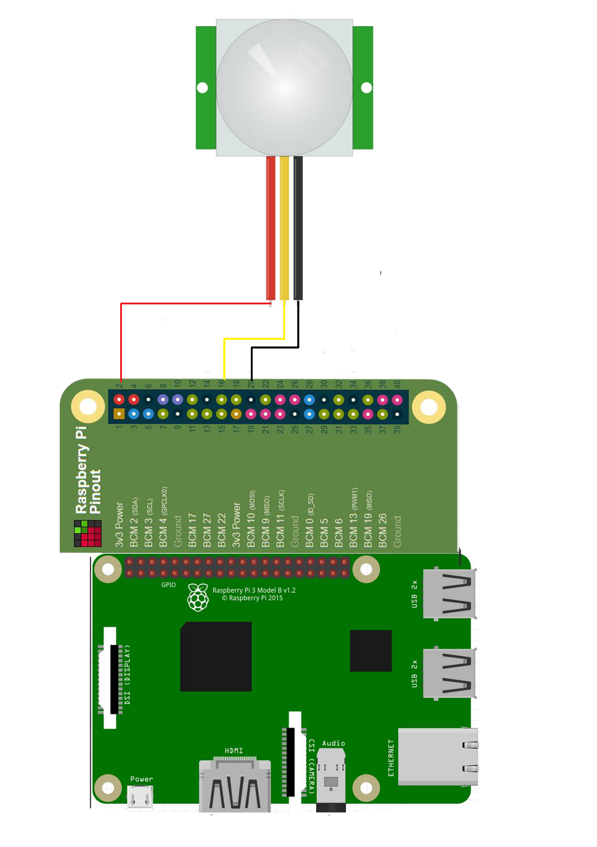
Circuit Description

Slide 14
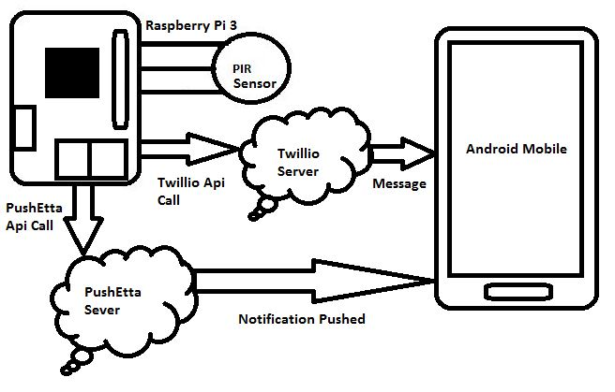
Block Diagram

Slide 15
Voice Controlled Chair Sitting Position
and
Automated Height Adjusting Back Rest

Slide 16
Benefits of Using this Module
The Chair is given voice command through an android application that will convert speech to text using speech recognizer.
These commands are transmitted through Bluetooth communication to Bluetooth module.
This linear actuator motion will determine the chair is in sitting position or resting position.

Slide 17
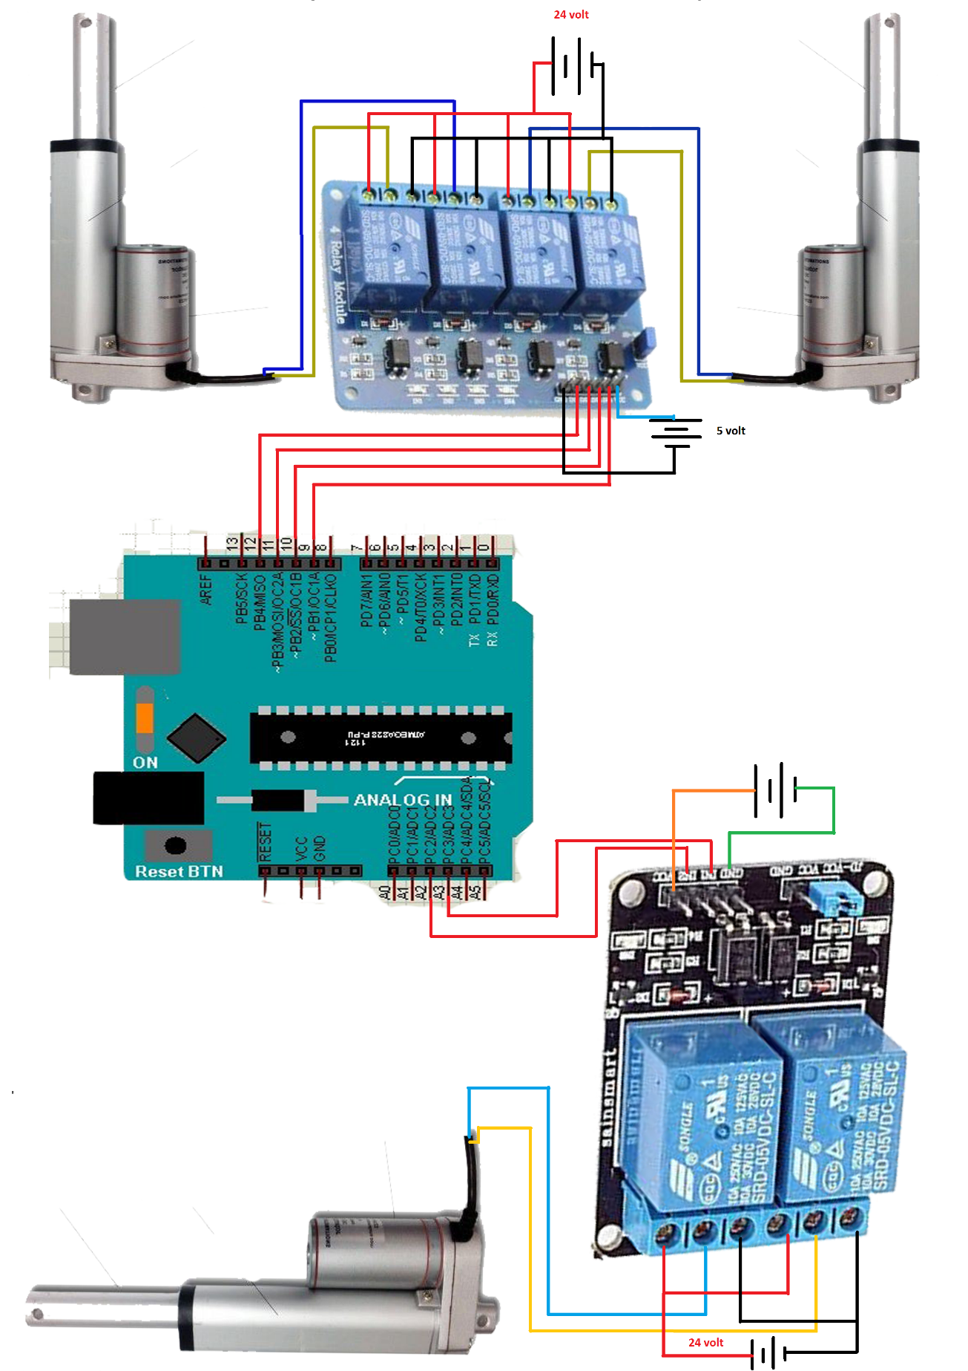
Circuit
Description

Slide 18
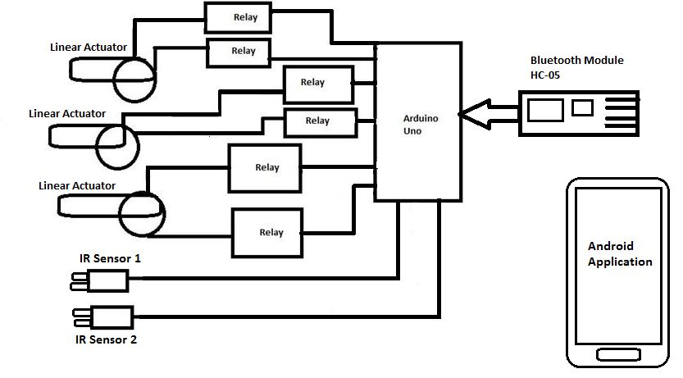
Block Diagram

Slide 19
Tracking Sitting Posture

Slide 20
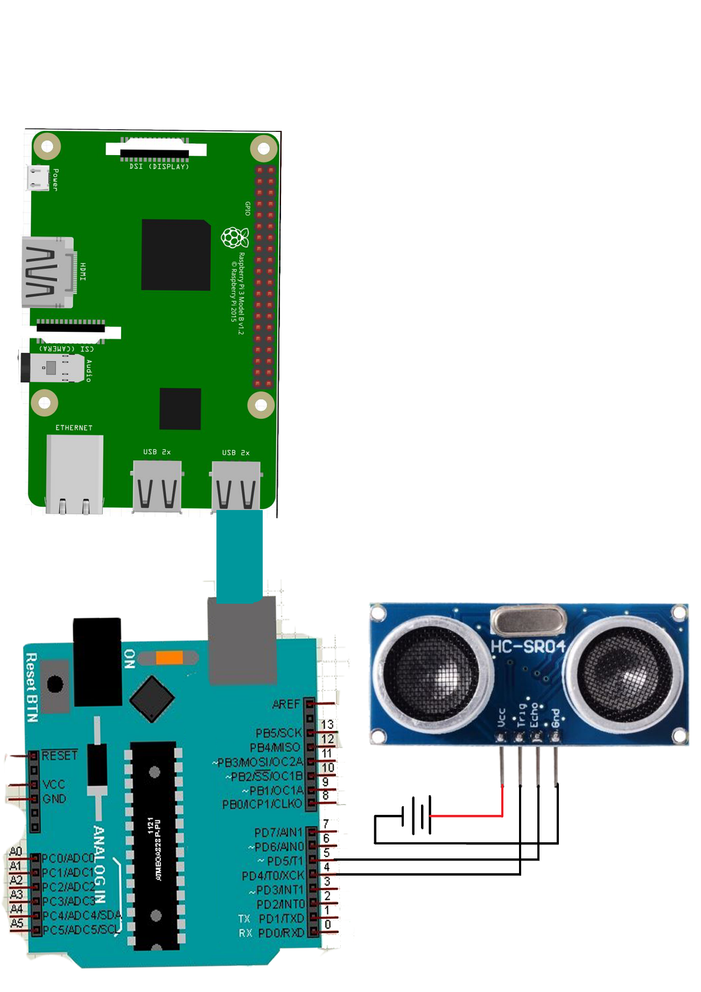
Circuit Description

Slide 21
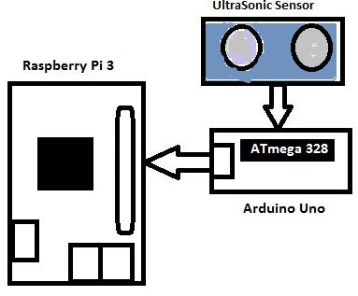
Block Diagram

Slide 22
Future Scope
This chair can be used in offices that have separate Desktops for systems and chairs separate.
Instead this smart chair comes with a combination of a computer as well as chair for resting.
So the onboard computing applications like excel worksheets, web browsers, PowerPoint presentations can be made on the same chair.
In this way it is economical as well as an innovative approach.

Slide 23
Future Scope
This makes working conditions interactive for the user.
This chair is also designed by keeping in mind the students study chair or study table.
In future every company is investing huge time and economy in saving natural resources.
This chair is also build to support that research. Because the chair has a feature of Digital Notes there is no requirement of pen or paper to record his or her writings.
It can also be used in hospitals for patients having backache.

Slide 24
THANKS!

